Slide 1
8086 microprocessor

Slide 2
Features of 8086 microprocessor
It is 16-bit microprocessor
It has a 16-bit data bus
So it can read/write data to memory
It has 20-bit address bus
Can access up to 2²⁰ memory (1mb)
Support up to 64k I/O ports
Provides 14, 16-bit registers
It has multiplexed address and data bus
AD0 – AD15 & A16 – A19
Its supports 2 modes of operations
MIN MODES
MAX MODES

Slide 3
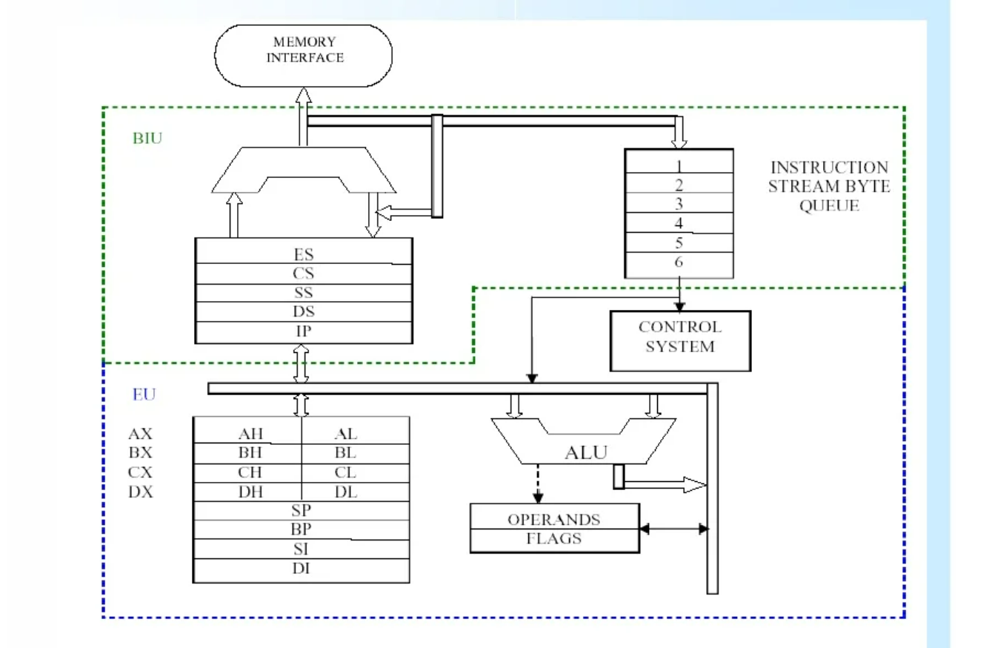
Architecture of 8086 microprocessor
Its divided into two independent functional units.
BIU (Bus Interface Unit)
EU (Execution Unit)
Dividing the work between these two units speed up processing.

Slide 4
Execution Unit (EU)
8086 microprocessor architecture has 16bit.
4 general-purpose registers.
AX, BX, CX, DX,
and those can be a divide in to AH, AL, BH, BL, CH, CL, DH, DL.
A pipeline is a method that can fetch data from memory while executing an instruction. Without a pipeline, the system can do one thing at a time.
That means to fetch, decode, and execute then fetch the next instruction decode and execute.
The EU has a 16-bit arithmetic logic unit (ALU) which can add, subtract, AND, OR, XOR, increment, decrement, complement or shift binary numbers.
The main functions of EU are:
Decoding
Execution

Slide 5
Execution Unit (EU)
The EU contains the following 16-bit registers:
AX – Accumulator
BX – Base Register
CX – Count Register
DX – Data Register
SP – Stack Pointer
BP – Base Pointer
SI – Source Index Register
DI – Destination Index Register
The AX, BX, CX and DX registers can be considered as two 8-bit registers.
High byte
Low byte
AX → AH, AL
BX → BH, BL
CX → CH, CL
DX → DH, DL

Slide 6
Pointers and Index Registers
IP – Instruction pointer store memory location of next instruction to be executed (code segment)
BP – Base pointer (data segment)
SP – Stack pointer (stack segment)
SI – Source index (source data in data segment)
DI – Destination index (destination in data or extra segment)
The index registers are particularly useful for string manipulation.

Slide 7
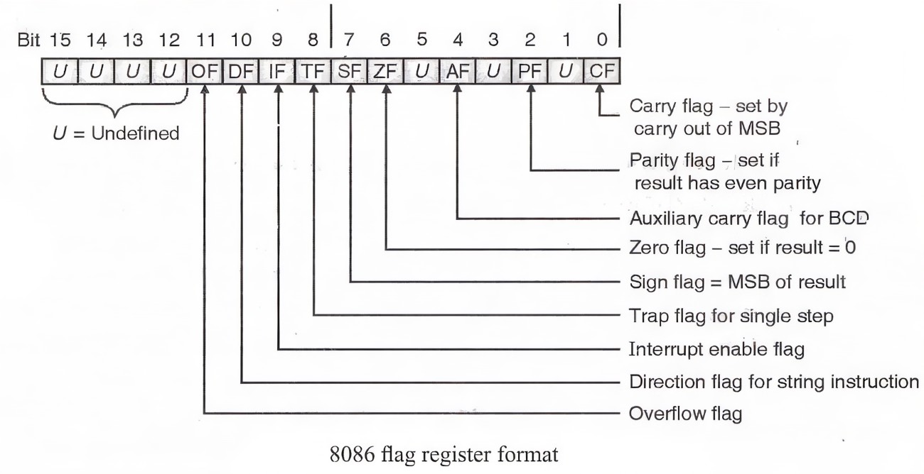
Flags Registers

Slide 8
Bus Interface Unit (BIU)
BIU calculates physical address by using segment address and offset address.
[ Physical address = segment address * 10H + Offset address ]
BIU fetch data from memory when the pre-fetch queue has two-byte of space.
Then fetch data from memory and store at the pre-fetch queue.
The pre-fetch queue can hold six-byte data.
Why six-bytes..?
The reason is 8086 instruction’s maximum size is 6 byte then the queue can hold any instruction.

Slide 9
Segment Registers
The 8086 architecture uses the concept of segmented memory.
Memory capacity – 1mb
Divided into 16 logical segments
Each one Contains 64kb
There are 4 segment registers
Code segment register(CS) –addressing memory location
Data segment register(DS) –point to the data segment
Extra segment register(ES)
Stack segment register(SS)

Slide 10
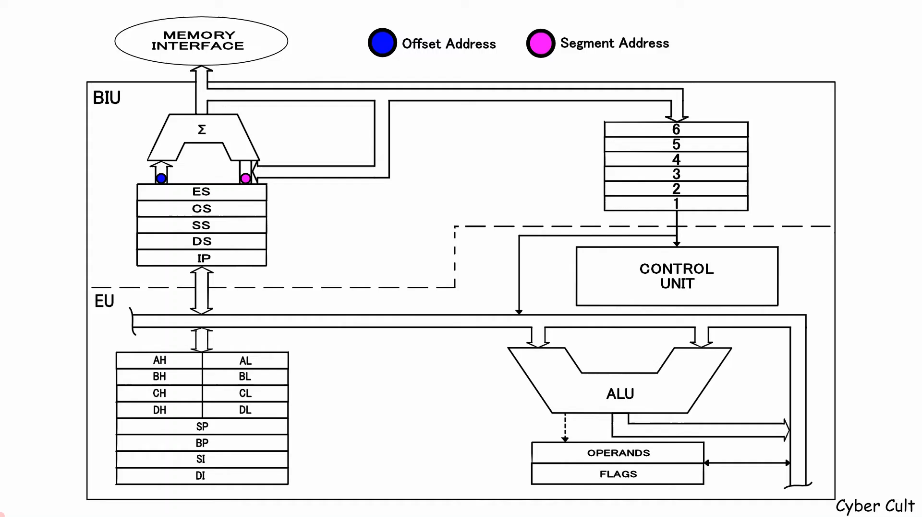
How instruction flow-through 8086 architecture

Slide 11
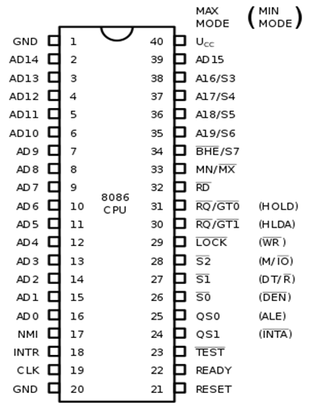
8086 - Pin Diagram

Slide 12
8086 - Pin Configuration
GND : Larger currents to the ground.
AD14-AD0, AD15 : These lines are called multiplexed lines.
NMI : its not user controlled, its reach processor when interrupts generates once.
INTR : its user controlled, we can enable / disable.
CLK : its signal used for synchronization between processor and all components

Slide 13
8086 - Pin Configuration
READY : active high pin(logic 1), used by the external peripherals.
READY = 0 (ready for accept data)
READY = 1 (not ready for accept data)
TEST : this pin is used along with wait instruction.
QS1&QS2 : it gives the status & instructions Queue
Qs1 Qs0 Meaning
0 0 No operation
0 1 first byte of opcode from Queue
1 0 Queue is cleared
1 1 next byte of opcode from Queue

Slide 14
8086 - Pin Configuration
S0’, S1’, S2’ : This indicates the type of operations carried out by the processor.
S0’ S1’ S2’ FUNCTION
0 0 0 interrupts acknowledge
0 0 1 I/O read
0 1 0 I/O write
0 1 1 Halt (not doing anything)
1 0 0 opcode fetch
1 0 1 memory read
1 1 0 memory write
1 1 1 passive (ideal state)

Slide 15
8086 - Pin Configuration
LOCK’ : its going for lock the system bus.
LOCK = 0
LOCK = 1
R1’/GT1’ /,R0’/GTO’ (request/grant) : In case of MAX mode if multiple processor are connect if the other processor wants to access the bus.
MN/MX’ : selecting min mode / max mode
Pin connected to VCC /programmed to 1 → MIN MODE
Pin connected to GROUND → MAX MODE

Slide 16
8086 - Pin Configuration
BHE’/S7 : bus high enable
Its representing what type of data processor accessing.
BHE A0 INDICATION
0 0 whole word (64k)
0 1 upper data/ from odd bank
1 0 lower data/ from even bank
1 1 none
A19/S6 – A16/S3 : address/ status bus (multiplexed)
S6 : always remains logic 0
S5 : indicate condition of FLAG bits

Slide 17
8086 - Pin Configuration
S4, S3 : represent which segment is currently the processor accessing.
S4 S3 Segment
0 0 ES
0 1 SS
1 0 CS
1 1 DS
RD’ : read signal is active low pin (logic =0)
VCC : MAX voltage we can give at here is +5.0 V

Slide 18
Thank You!!

